Slide 1
Devices and I/O
CS422/522 Lecture 12
20 October 2014
Last updated: 20 October 2014

Slide 2
Outline
Recap
Devices and I/O
Processor I/O
Direct Memory Access
Discussion
Wrap-Up

Slide 3
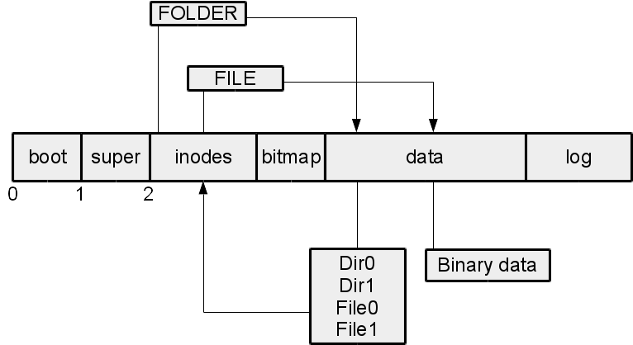
Recap
File System Overview

Slide 4
Network File Systems
Share folder / files across Network
Benefits:
  Deduplication of data
  Shared home directories
  Convenient access to common files
Challenges:
  Access permissions
  Where to store state
  Coherency

Slide 5
FUSE
File-System in User-Space
Operations occur in a virtual file system
Redirected toward user-space handler
Able to write fully functional FS: NTFS, SSHFS

Slide 6
Fragmentation
Files can grow over time
How are blocks in FS allocated?
Performance issues?

Slide 7
Outline
Recap
Devices and I/O
Processor I/O
Direct Memory Access
Discussion
Wrap-Up

Slide 8
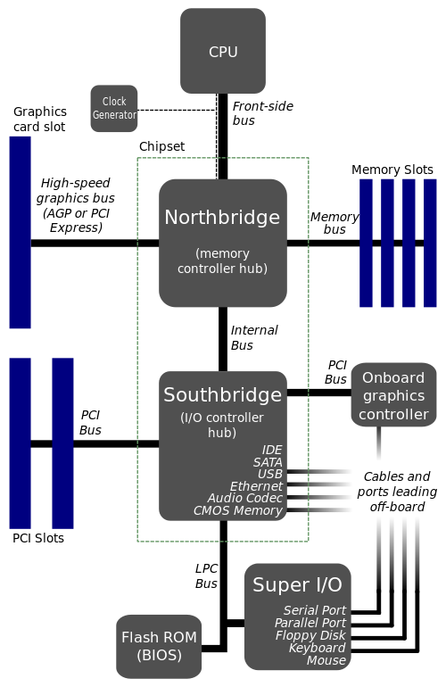
PC Organization

Slide 9
Different Types of Devices
Video
Sound
Network
Persistent storage devices
Cameras
Keyboard, mouse, etc
Printers, scanners
Accelerator cards: physics, coprocessors, FPGAs

Slide 10
Connecting Devices
External:
  Parallel
  Serial
  Game (controller)
  USB
Internal:
  ISA, E-ISA
  PCI, PCI-E, PCI-X

Slide 11
Communicating with Devices
I/O operations -- 65K portsParallel
  in data, src -- data = in(port)
  out dst, data -- out(port, data)
Memory operations
Both are address spaces and byte addressable

Slide 12
PIO vs DMA
PIO - Processor I/O:
  Application directly reads/writes to device
DMA - Direct memory access:
  Application has a read or write buffer
  Directly informs device about buffers physical memory
  Issues read / write command
  Application yields until device interrupt

Slide 13
Outline
Recap
Devices and I/O
Processor I/O
Direct Memory Access
Discussion
Wrap-Up

Slide 14
PIO of ATA/IDE Disks
All computers come equipped with two ATA bus (channel)
Two drives per channel (master / slave)
Accessible on 0x1f0 to 0x1f7 and 0x170 to 0x177
Process:
  Detect disks
  Read from disk
  Write to disk

Slide 15
ATA I/O Ports
Port Off. Function Description
0 Data Port Read/Write PIO.
1 Features / Error Information Usually used for ATAPI devices.
2 Sector Count Number of sectors to read/write.
3 LBAlo Address 7..0.
4 LBAmid Address 15..8.
5 LBAhi Address 23..16.
6 Drive / Head Port Drive select / Address 27..24.
7 Command / Status port Send commands / read status.

Slide 16
Status
Bit Abbreviation Function
0 ERR An error occurred.
3 DRQ Drive ready for data transfer.
4 SRV Overlapped Mode Service Request.
5 DF Drive Fault Error, ERR not set.
6 RDY Bit is clear when drive is spun down.
7 BSY Busy drive, wait.

Slide 17
Detecting Disks
ide_wait_ready() {
while (((r = inb(dev + 7)) < (BSY|RDY)) != RDY);
}
int check_disk(int8_t dev, int8_t slave) {
ide_wait_ready();
outb(dev + 6, 0xE0 | (slave<<4));
for (i=0; i<1000; i++)
if((inb(dev + 7) & ~(BSY | DF | ERR)) != 0)
return 1;
return 0;
}
ide0_master = check_disk(0x1f0, 0);
ide0_slave = check_disk(0x1f0, 1);
ide1_master = check_disk(0x170, 0);
ide1_slave = check_disk(0x170, 1);

Slide 18
int ide_read(int8_t dev, int8_t slave, uint32_t secno,
void *dst, size_t nsecs)
{
ide_wait_ready();
outb(dev + 2, nsecs);
outb(dev + 3, secno & 0xFF);
outb(dev + 4, (secno >> 8) & 0xFF);
outb(dev + 5, (secno >> 16) & 0xFF);
outb(dev + 6, 0xE0 | ((slave)<<4) |
((secno>>24)&0x0F));
outb(dev7, 0x20);
for (; nsecs > 0; nsecs--, dst += SECTSIZE) {
ide_wait_ready();
insl(dev, dst, SECTSIZE/4);
}
return 0;
}

Slide 19
int ide_write(int8_t dev, int8_t slave, uint32_t secno,
const void *src, size_t nsecs)
{
ide_wait_ready();
outb(dev + 2, nsecs);
outb(dev + 3, secno & 0xFF);
outb(dev + 4, (secno >> 8) & 0xFF);
outb(dev + 5, (secno >> 16) & 0xFF);
outb(dev + 6, 0xE0 | ((slave)<<4) |
((secno>>24)&0x0F));
outb(dev7, 0x30);
for (; nsecs > 0; nsecs--, src += SECTSIZE) {
ide_wait_ready();
outsl(dev, src, SECTSIZE/4);
}
return 0;
}

Slide 20
Outline
Recap
Devices and I/O
Processor I/O
Direct Memory Access
Discussion
Wrap-Up

Slide 21
DMA of ATA Drives
Detect ATA Controller via PCI
Access base address registers
Setup DMA table
Read / Write

Slide 22
Finding Our Devices
In lab 6, we add PCI support to Jos, here's a sample output:
PCI: 00:00.0: 8086:1237: class: 6.0 (Bridge device) irq: 0
PCI: 00:01.0: 8086:7000: class: 6.1 (Bridge device) irq: 0
PCI: 00:01.1: 8086:7010: class: 1.1 (Storage controller) irq: 0
PCI: 00:01.3: 8086:7113: class: 6.80 (Bridge device) irq: 9
PCI: 00:02.0: 1013:00b8: class: 3.0 (Display controller) irq: 0
PCI: 00:03.0: 8086:100e: class: 2.0 (Network controller) irq: 11

Slide 23
Scanning a PCI Bus
PCI bus consists of up to 32 devices
May have layered buses, starts at 0
Each device can support up to 8 different functions
Consists of a "unique" vendor and device ID
PCI: 00:01.1: 8086:7010: class: 1.1 (Storage controller) irq: 0

Slide 24
ATA I/O Ports
register bits 31-24 bits 23-16 bits 15-8 bits 7-0
00 Device ID Vendor ID
04 Status Command
08 Class code Subclass Prog IF Revision ID
0C BIST Header type Latency Timer Cache Line Size
10 Base address #0 (BAR0)
14 Base address #1 (BAR1)
18 Base address #2 (BAR2)
1C Base address #3 (BAR3)
20 Base address #4 (BAR4)
24 Base address #5 (BAR5)
3C Max latency Min Grant Interrupt PIN Interrupt Line

Slide 25
Scanning in Action
Recall I/O Ports are byte addressed
offset = 0; // device:vendor
uint32_t v = (1 << 31) | // config-space
((bus & 0xff) << 16) |
((dev & 0x20) << 11) |
((func & 0x8) << 8) |
(offset);
outl(0x0cf8, v);
uint32_t inl(0x0cfc); // if vendor == 0xffff, no device

Slide 26
Learning About the Device
PCI: 00:01.1: 8086:7010: class: 1.1 (Storage controller) irq: 0
Each device has 6 base address registers (bars):
  At first read, contains address and a bit to define IO or memory
  Write 0xffffffff and read again to obtain size
io region 4: 16 bytes at 0xc040

Slide 27
Talking to the Device
bar4 points to bus master register:
0x0 -- Primary Command (byte)
0x2 -- Primary Status (byte)
0x4 -- Primary DMA Table (4 bytes)
0x8 -- Secondary Command (byte)
0xA -- Secondary Status (byte)
0xC -- Secondary DMA Table (4 bytes)
inl(0xc040 + 2); // read status from primary

Slide 28
Command and Status
Command byte:
  0x1 - Begin a DMA transfer
  0x8 - Read/Write, set only when DMA bit is 0
Status byte:
  0x1 - Set when starting DMA, cleared DMA finished
  0x2 - DMA failure
  0x4 - IRQ, set to 0 to reset
  0x20 - Master device ready for DMA
  0x40 - Slave device ready for DMA

Slide 29
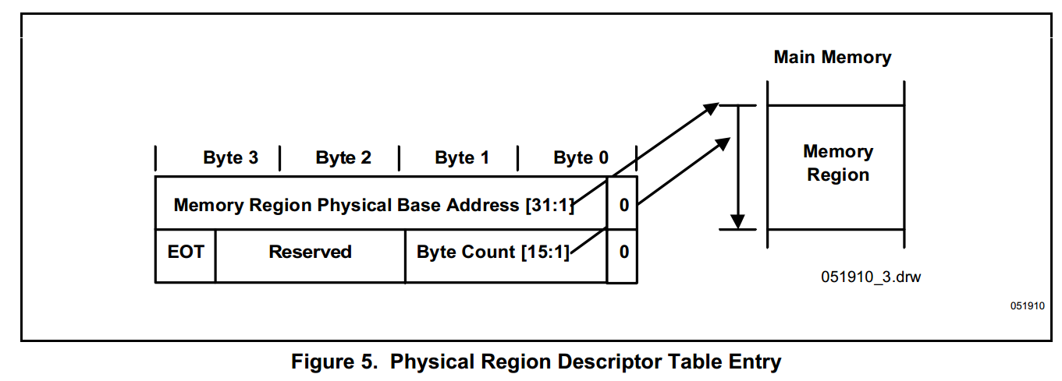
DMA Tables

Slide 30
Setting the Devices for DMA
Set DMA mode: out(dev + 1, 1)
IDE devices use SCSI Commands for DMA
Execution of Commands similar to PIO:
  Write the number of sectors into dev + 2
  Write address into dev + 3 to dev + 6
  Specify command: 0xC8 - read, 0xCA - write

Slide 31
Putting It Together
Allocate memory for the PRDT
Install physical address into DMA Table
Set the drive to run in DMA mode
Issue an SCSI read/write command
Prepare PRDT
Set read/write bit on command register
Set DMA bit on command register
Wait for interrupt
After handling interrupt, execute EOI

Slide 32
Outline
Recap
Devices and I/O
Processor I/O
Direct Memory Access
Discussion
Wrap-Up

Slide 33
PIO vs DMA
PIO:
  PIO is simpler
  Not too inefficient for singe processes
  Require 0 transitions between user / kernel
DMA
  Complex code
  Must map contiguous memory
  More difficult to make blocking
  Enables achieving maximum performance of device

Slide 34
Zero-Copy
Easy to have static memory for DMA
Requires at least one copy, user memory to DMA memory
Issue: wasteful
what if we had the PRDT point to this memory:
  Each write must be in contiguous memory
  The contents cannot be changed after a write command
  The address to be read into must be in the applications space

Slide 35
Protection
eflags has IOPL -- IO Privilege level
CPL <= IOPL
Task state segment has IO port permissions
What happens if we don't have permission?

Slide 36
Outline
Recap
Devices and I/O
Processor I/O
Direct Memory Access
Discussion
Wrap-Up

Slide 37
Lab 4 Review

Slide 38
Midterm
Review labs, lecture notes, and assigned papers
Short answer questions based upon applying concepts learned
Use x86 concepts or define a pseudomachine interface: PTE_U vs PTE_S
No need to memorize unique addresses
No coding
Nothing overly specific about papers, understand the main concept
Background and hints will be provided

Slide 39
Next Time
22 Oct -- Recess
27 Oct -- Midterm
29 Oct -- Hack day
3 Nov -- Networking
Lab 5 due 30 Oct
Lab 6 is posted, due 13 Nov

